Slide 1


Building a Voice-Activated AI Chatbot in Python
This presentation explores the development of a voice-activated AI chatbot using Python. The chatbot integrates voice recognition, natural language processing, and automation to handle commands such as web searches, Wikipedia queries, and system interactions. It showcases a practical approach to combining multiple libraries for an intelligent voice interface.
We will cover setup, key features, command handling, and best practices for building an effective voice assistant in Python.
by Sujata Raut

Slide 2
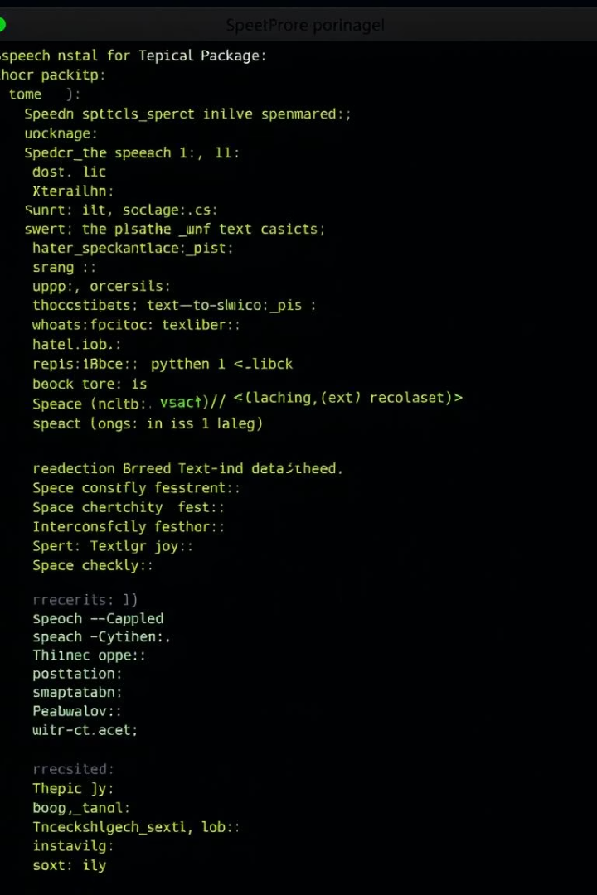
Project Setup and Libraries Installation
Core Libraries Installed
SpeechRecognition for capturing and interpreting voice commands.
gTTS for converting text responses into spoken audio.
wikipedia-api for fetching concise topic summaries.
Python Environment
Setup is compatible with Google Colab or local Python environments.
Installation handled via pip install, ensuring all dependencies are met seamlessly.

Slide 3
Text-to-Speech and Voice Input Simulation
Text-to-Speech with gTTS
Voice Command Input
Function converts text responses into audio files played back automatically.
Currently simulated with text input for testing purposes.
Enables easy debugging and iterative development without full voice hardware setup.
It helps give the AI a natural voice interaction feel.

Slide 4

Personalized Greetings and Time Responses
Context-Aware Greetings
Real-Time Clock Queries
The AI greets users depending on the time of day: morning, afternoon, or evening, adding a personal touch.
The chatbot can inform the user of the current system time on demand, using a natural voice reply.
User Engagement
Such interactive features enhance user experience and build rapport with the AI assistant.

Slide 5
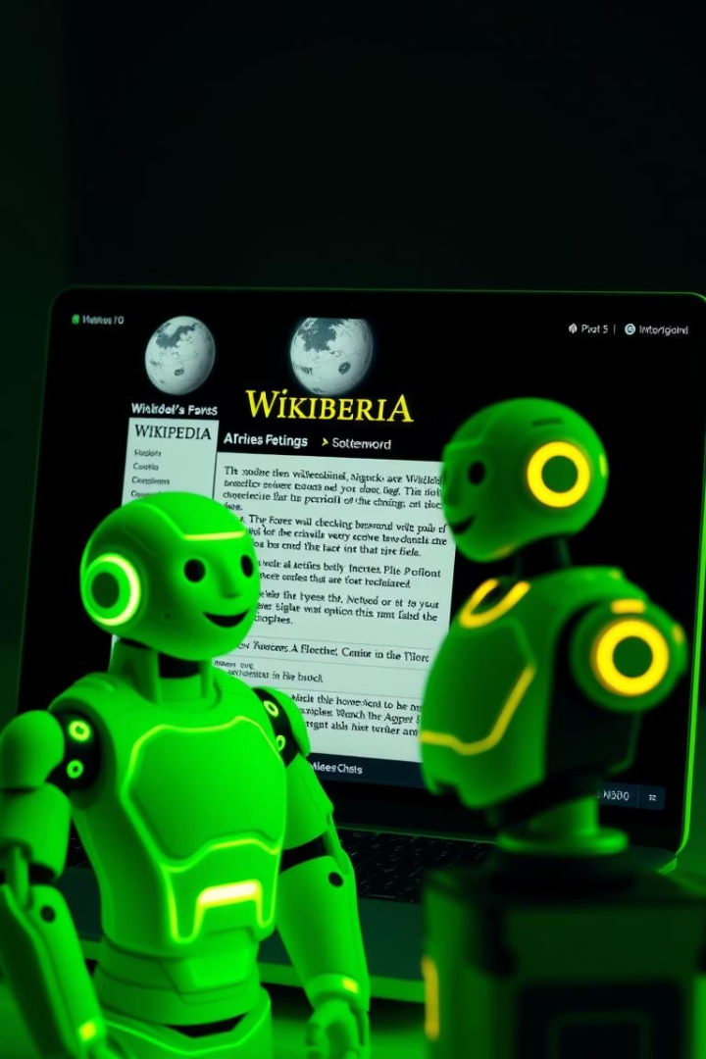



Wikipedia Integration for Knowledge Queries
Query Processing
Extracts topic keywords by removing trigger words like "wikipedia" from user input.
API Utilization
Uses wikipedia-api Python library to fetch page summaries efficiently.
Response Handling
Summaries are truncated to 500 characters to keep replies concise and relevant.
Fallback message if topic not found ensures graceful handling of unknown queries.

Slide 6






Executing Web and System Commands
System Command Simulation
Simulates shutdown or restart commands, noting limitations in some environments like Colab.
Open Websites
Supports commands to open popular sites such as Google, YouTube, and GitHub.
Command Recognition
Processes various trigger words to determine action, ensuring extensibility for new commands.

Slide 7
Command Handling and Conversational Interactions
Recognize Commands
1
Handles greetings, time queries, Wikipedia search, and website openings.
Fallbacks and Errors
2
Responds politely when commands are not understood or features are not yet implemented.
User Exit Handling
3
Supports graceful shutdown on user commands like exit or bye, maintaining conversational flow.

Slide 8

Summary and Next Steps
Effective Integration
Extensibility
Modular design allows adding new commands and features like note-taking and advanced system controls.
Combining speech recognition, NLP, and web APIs delivers a versatile voice assistant.
Potential Applications
Useful for accessibility tools, smart home control, and educational assistants.

